Slide 1
Unit 1: Overview of Sterling File Gateway
© Copyright IBM Corporation 2015
Notes:
© Copyright IBM Corporation 2015

Slide 2
Unit objectives
Explain the Sterling File Gateway application terms and concepts.
Discuss the Sterling File Gateway installation.
Explain users, trading partners groups and communities.
Create routing channel template and routing channel for static route.
© Copyright IBM Corporation 2015
Notes:
© Copyright IBM Corporation 2012

Slide 3
Lesson 1
Introduction
© Copyright IBM Corporation 2015
Notes:
© Copyright IBM Corporation 2012

Slide 4
Lesson objectives
Describe the major functions of Sterling File Gateway.
Explain the terms and concepts of Sterling File Gateway.
List the enhancements in Sterling File Gateway V2.2.6.
Install and start the Sterling File Gateway application.
© Copyright IBM Corporation 2015
Notes:
© Copyright IBM Corporation 2015

Slide 5
Introduction to Sterling File Gateway
SFG is an application for transferring files between partners using different protocols, file naming conventions, and file formats.
SFG utilizes the Sterling B2B foundation, which includes Sterling Integrator, Sterling Standards, and the Sterling platform.
SFG can be accessed using unique application URL, provides single sign-on access to the Sterling Integrator administrative console through menu selection.
It helps in transfer of high volume payloads with end-to-end visibility of file movement.
© Copyright IBM Corporation 2015

Slide 6






File Gateway is a Router
Sterling File Gateway Router
Community
Producer
Mailboxes
Consumer
Mailboxes
Listening
Consumer
(ex: Customer)
Producer
Initiating
Consumer
(ex: Partner)
Produces the file and uploads to the mailbox system
Listening
Consumer
(ex: Server)
File Gateway Router
Consumes the file when the file is pushed or retrieved from a mailbox

Slide 7
Features
File name transformations: It provides a flexible way to map input filenames to output with the use of regular expressions. It can extract fact names from filenames. common file processing tasks such as compression/decompression, PGP encryption/decryption, and signing
File Transfer Visibility: Events are recorded for monitoring and reporting; Ability to view and filter Sterling File Gateway data flows for all users.
Replay/Redeliver: One click replay/redeliver capability that allows users to reprocess a transmission from the beginning, to a specific delivery destination.
Notifications : Partners and operators can subscribe to be notified about events by email.
Extensibility: Custom event codes, custom protocols, custom file layer and consumer identification policies can be added to support unique scenarios.
File Format : SFG can wrap and unwrap data for zip, gzip and pgp formats

Slide 8
Features (Contd..)
Broad Communications Protocol Support FTP, FTP/S, SSH/SFTP, and Connect:Direct and (such as HTTP,AS2, AS3, or Odette FTP) can be setup by custom protocols.
Partner Interface (myfilegateway) – Web browser-based interface that enables partners to upload/download files.
Role Based Access – fg_sysadmin, Integration Architect, Producer/Consumer (end user).
Partner On boarding – Easy-to-use graphical user interface to
onboard partners.

Slide 9
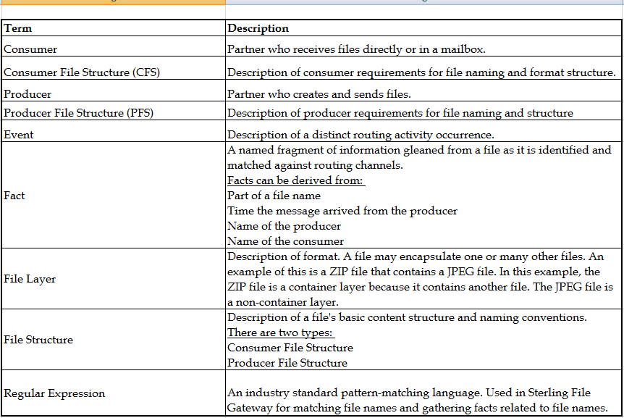
Terms to Understand

Slide 10
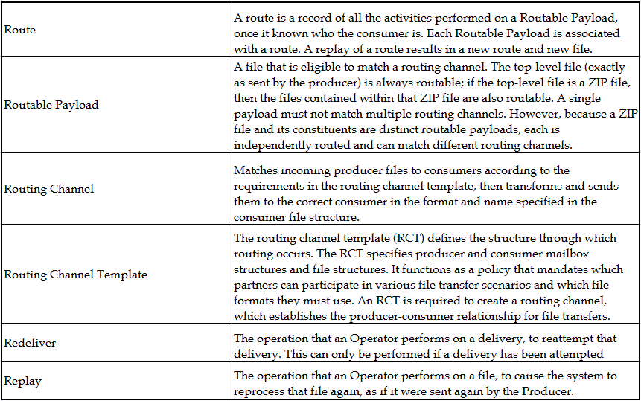
Terms to Understand (Contd..)

Slide 11
EBICS
Electronic Banking Internet Communications Standard (EBICS) is a secure transport protocol and a B2B specification for electronic financial transactions between corporate firms and banks, and between banks.
EBICS continues to grow in acceptance across Europe, for many types of secure communication. EBICS communication has become Any-to-Any between participants, that include:
  Bank to Bank
  Corporate to Bank(s)
  Financial Services to Banks (Clearing Center)
  Insurance to Banks
© Copyright IBM Corporation 2015

Slide 12
Enhancements
Mass File Replay.
Integration with IBM Partner Engagement Manager.
Listening Producer API.
EBICS operators.
Access and protocol support for FTP, SFTP, Connect:Direct, myfilegateway for high availability and disaster recovery.
Flexible integration with any partners, systems.
Improved operation efficiency, business performance and empowered data movement.
© Copyright IBM Corporation 2015

Slide 13

Installing Sterling File Gateway
Sterling File Gateway is available with Sterling B2B Integrator installer. The Sterling File Gateway can be installed in one of the following ways:
  Installation Manager
  Install Service
Installation Manager:
Sterling File Gateway installation performed through IBM Installation Manager is called Installation Manager (IM). IM is a Graphical based installation.
Install Server:
Sterling File Gateway installation is performed through command line using the jar files.
It is always recommended to install Sterling File Gateway during Sterling B2B Integration installation.
© Copyright IBM Corporation 2015

Slide 14



Lab environment setup
Database DB210.1 and ISB2BI V5.2.6, IM_1.8.2,JDK 7.0.9, WAS,WMQ
Hostname: server
IP: 192.168.40.100
Port: 9000-9200 for ISBI, DB2 50,000, WAS 8000-8100
Linux JDK ibm-java-sdk-7.0.9.10-linux-x86_6.tgz
DB name=STUDENT
User=db2inst1
Pwd = root123
Tablespace = TS_STUDENT
Port=50000
SIINSTALLDIR=/opt/ISBI
User=admin
Pwd = password
Port = 9000
server
Embedded WAS 8.5.5.6 Linux version
WebSphere MQ8.0
JDK 7.0.9, DB2 Client, FTP Client, Notepad++,MailServer, PuTTY
Hostname: client
IP: 192.168.40.1
Port : default ports
student1@ibm.com
Microsoft Internet Explorer 11
Mozilla Firefox 38
Windows JDK ibm-java-sdk-70-win-x86_64.exe
And X-windows compatible tool 2.5.4 or higher
client
The screen depicts SKYTAP setup for the course to perform exercise. Instructor will assign the URL and demonstrate the environment.
Notes:
For more details, refer system requirement document from IBM knowledge center
http://www-969.ibm.com/software/reports/compatibility/clarity-reports/report/html/softwareReqsForProduct?deliverableId=3F8014F0EC0F11E38B73BF6573FF9933&osPlatforms=Linux&duComponentIds=D003|D002|S001|S005|S004|S006&mandatoryCapIds=30|125|9|13|25|184|26#

Slide 15

Exercise
Graphic must not be moved, added to, or altered in any way.
  Accessing the lab environment
    The instructor will provide the URL to your lab
    User Credentials
Notes:
Please see the exercise manual to start and enter the individual environments

Slide 16
Completed lesson objectives
Describe the major functions of Sterling File Gateway.
Explain the terms and concepts of Sterling File Gateway.
List the enhancements in Sterling File Gateway V2.2.6.
Install and start the Sterling File Gateway application.
© Copyright IBM Corporation 2015
Notes:
© Copyright IBM Corporation 2015

Slide 17

Questions
© Copyright IBM Corporation 2015
Notes:
© Copyright IBM Corporation 2015

Slide 18
Lesson 2
Users and Trading Partners
© Copyright IBM Corporation 2015
Notes:
© Copyright IBM Corporation 2012

Slide 19
Lesson objectives
Explain the importance of users in Sterling File Gateway.
List built in users of Sterling File Gateway.
Explain about communities, groups and trading partners.
Create communities, groups, partners and users.
© Copyright IBM Corporation 2015
Notes:
© Copyright IBM Corporation 2015

Slide 20
Sterling File Gateway Persona
Sterling File Gateway users are described as user accounts. Inherently, each user account has different access levels to Sterling File Gateway and may have different landing pages in Sterling File Gateway as per their permissions.
There are five different user accounts in Sterling File Gateway:
  System Administrator
  Integration Architect
  Route Provisioner
  Operator
  Partner User

Slide 21
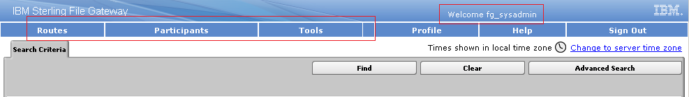
System Administrator
System Administrator
  Installs and maintains system software.
  Creates initial administrative users.
  Configures services and adapters for sending and receiving files.
  http://192.168.40.100:9000/filegateway
  User : fg_sysadmin
  Password : password

Slide 22
Sterling File Gateway Persona
Integration Architect
  Creates, manages, and deletes
  partner groups,
  Communities
  routing channel templates,
  producer file structures, and consumer file structures.
  http://192.168.40.100:9000/filegateway
  User : fg_architect
  Password : password

Slide 23
Sterling File Gateway Persona (Contd..)
Route Provisioner
  Creates and manages :
  partners,
  Group membership and
  Routing channels.
  http://192.168.40.100:9000/filegateway
  User : fg_provisioner
  Password : password

Slide 24
Sterling File Gateway Persona (Contd..)
Operator
  Monitors the system status and file activities.
  Troubleshoots problems with partner activities,
  Generates reports uses logs, and subscribes for their own notifications.
  http://192.168.40.100:9000/filegateway
  User : fg_operator
  Password : password

Slide 25
Sterling File Gateway Persona (Contd..)
Partner User
  Uploads and downloads files from myfilefateway.
  Views their own activity, subscribes to their own notification about their activities, manages their password, and generates reports.
  http://192.168.40.100:9000/myfilegateway
  User : <Partneruser>
  Password : <password>

Slide 26
Sterling File Gateway Persona (Contd..)
The System Administrator, Integration Architect, Route Provisioner, and Operator users are considered to be administrative users and members of the company that is using Sterling File Gateway to manage their file transfer business needs.
The Partner User is not a member of the company that is using Sterling File Gateway. The Partner User is a member of a trading partner company and has access to only myFileGateway.

Slide 27
Communities
A community represents a way to organize partners for purposes of on boarding in Sterling File Gateway.
Communities are used to limit or widen the selection of protocols available when creating partners. They are also used to enable listening or initiating modes of connection.
A community is required to create a partner.
The community must exist before the partner is created.
Integration Architects manage communities.

Slide 28
Communities
We may have the following community categories:
  • FTP only
  • SFTP only
  • HTTP only
  • Connect:Direct only
  • Listening only
  • Initiating only

Slide 29
Groups
Groups provide more flexibility than communities. Groups help a company to logically organize their partners according to the business needs of the company.
For example, you may have the following types of groups:
  Divisions or locations
  File types
  Encryption requirements
Upon installation of Sterling File Gateway, a group named
All Partners is created. By default, each partner is automatically associated with the All Partners group when they are created in Sterling File Gateway. The All Partners group cannot be deleted.

Slide 30
Groups (Contd..)
Partners must be a member of at least one group. Partners can be a member of multiple groups.
Assigning partners to groups allows the partners to participate in any transfers using templates where they group is specified.
Groups allow a company to organize their trading partners by business needs. A trading partner can exist in more than one group, which makes Groups more flexible and allows companies to organize trading partners by business needs rather than imposing trading partner organization by protocol (as communities do).

Slide 31
Partners
Sterling File Gateway enables the exchange of files between trading partners are called partners.
Partners that send files into Sterling File Gateway are referred to as producers.
Partners that retrieve files are referred to as consumers. A partner can be a producer, a consumer, or both from an operational standpoint.

Slide 32
Exercise
Graphic must not be moved, added to, or altered in any way.
  Community Creation.
  Group Creation.
  Partner Creation.
  Attaching a partner to a group.
Notes:
© Copyright IBM Corporation 2015

Slide 33
Completed lesson objectives
Explain the importance of users in Sterling File Gateway.
List built in users of Sterling File Gateway.
Explain about communities, groups and trading partners.
Create communities, groups, partners and users.
© Copyright IBM Corporation 2015
Notes:
© Copyright IBM Corporation 2015

Slide 34
Questions
© Copyright IBM Corporation 2015
Notes:
© Copyright IBM Corporation 2015

Slide 35
Lesson 3
Routing Channel Template
© Copyright IBM Corporation 2015
Notes:
© Copyright IBM Corporation 2012

Slide 36
Lesson objectives
Describe the components of a Routing Channel Template.
Explain the difference between System facts and Custom facts.
Describe the file structures usage in Sterling File Gateway.
Explain the difference between container and non-container file layers.
© Copyright IBM Corporation 2015
Notes:
© Copyright IBM Corporation 2015

Slide 37
Routing Channel Template
The routing channel template (RCT) is a fundamental concept in the Sterling File Gateway application:
  The RCT defines the structure through which routing occurs.
  The RCT specifies consumer and producer mailbox structures and file structures. It functions as a policy that mandates which partners can participate in various file transfer scenarios.
  A RCT is required to create a routing channel, which establishes the producer-consumer relationship for file transfers.
Routing channel templates are created by users defined with Integration Architect access.

Slide 38
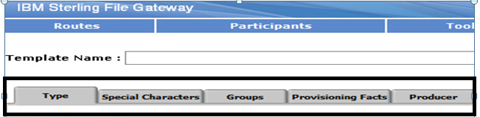
Routing Channel Template (Contd..)
Routing channel templates are comprised of:
  Template type - static or dynamic
  Special characters handling
  Groups
  Producer mailbox and file structure
  Consumer delivery channel

Slide 39
Template type: RCT
Static Template - A static routing channel template requires that the corresponding routing channels specify a single consumer and does not allow for any variability in that consumer.
Dynamic Template – In Dynamic Routing Channel template, consumer can be identified at the run time. Below are different ways to identify the Consumer name.
> Specify the Facts such as ConsumerName or ConsumerCode in the producer file structure. (File Based Routing)
> Specify a business process which will get the consumer name based on

Slide 40
Special Character: RCT
Special Characters :
Sterling File Gateway provides various options for handling special characters in file names. This option provides flexibility when the file name provided by the producer is not compatible with the consumer file naming convention.
Substitute characters individually:
For example, Search for character sequence ABC, Replace with 123 would translate a producer file name of:
Eg: Abbot.txt to a consumer file name of 1bbot.txt
Replace characters, then omit consecutive replacements:
Enter which sequence to substitute with what new sequence. For example, Search for [*%$] Replace with –
Eg: The following producer file name A*%B.txt is translate to A-B.txt to a consumer file name

Slide 41
Special Character: RCT (Contd..)
Remove characters.
Remove Windows invalid characters /\:*?"<>|;%.
Remove UNIX invalid characters /;\'!#$&*|'"?<>).
Remove all characters, except alphanumeric, dash, and period.

Slide 42
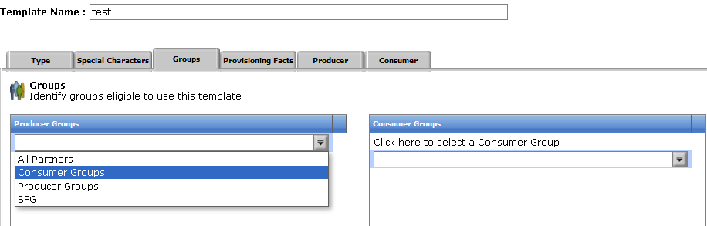
Groups
The group tab allows you to select the producer groups and consumer groups that can use the template.
You can select one or more producer groups and consumer groups.
Only members of these groups are eligible partners for the routing channel.

Slide 43
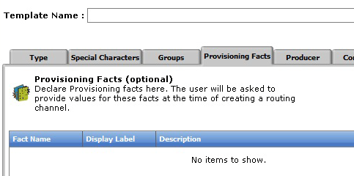
Provisioning Facts : RCT
Provisioning facts provide a controlled way to customize particular routing channels (RCs) within the context of a particular routing channel template.

Slide 44
Producer: RCT
The producer tab allows you to specify the producer mailbox name pattern and producer file structure.
The mailbox is used to define where in the producers mailbox structure outgoing files are going to be dropped off.
The Producer File Structure is consisted of the following information:
  File type.
  File name pattern as regular expression.
  File name pattern group fact names, comma delimited.

Slide 45
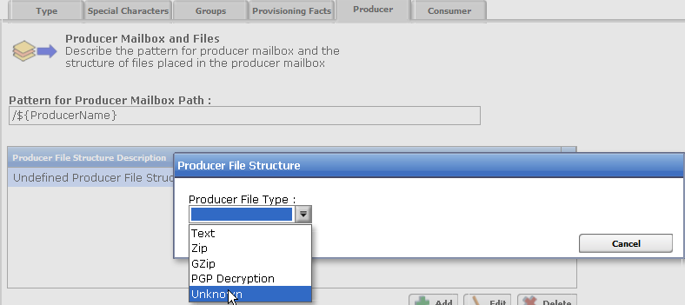
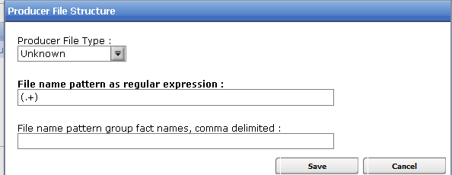
Producer: RCT (Contd..)

Slide 46
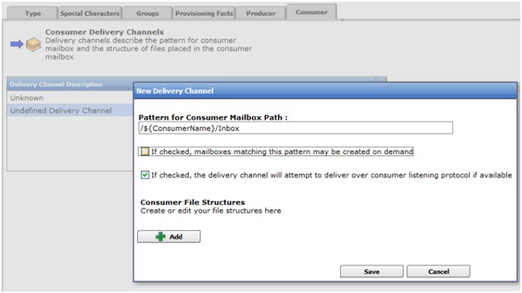
Consumer: RCT
The consumer tab allows you to specify the delivery channel, including the consumer mailbox pattern and consumer file structure. You can check whether you would like Sterling File Gateway to create mailboxes on demand as needed.

Slide 47
Facts
A fact is a named piece of known information about an executing routing channel, for example.
It is basically helps in indemnifying the partner.
  A part of a file name.
  The time a message arrived from the producers transfer channel.
  The name of the producer.
  The name of the consumer.
Sterling File Gateway provides system facts and supports the specification of custom facts during routing channel template creation.
Most system facts can be used to build out the pattern for producer and consumer mailboxes and to define the producer and consumer file structures in the routing channel template.

Slide 48
System facts and custom facts
System Facts :
System facts are built in Facts
Some Examples:
ConsumerName: The name of the consumer
ConsumerCode : The code of the consumer
ProducerFilename: The name of the file that the producer sent
ProducerName: The name of the producing partner
ProducerCode: The code of the producing partner

Slide 49
Custom facts
In simple language custom facts are user defined facts.
Basically on requirements of the producer’s and consumer’s file naming structure the Facts can be defined.
User-created facts must be prefixed with the string “my” to clearly delineate between custom and system facts. For example:
  myFileName
  myDateTime
  myConcatenatedFilename

Slide 50
Example: Using system fact and custom fact
When using system Facts you have to use certain notations.
${factname} - Replaced with the value of factname
$${ - Produces a literal ${
Example:
${mySanitizedFilename}_${RoutingTimestamp}.zip
In the example, "mySanitizedFilename" was defined as a custom fact in the producer file structure, and "RoutingTimestamp" is a system fact.

Slide 51
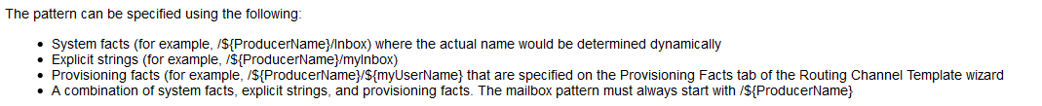
File structures: Producer file structure
A producer file structure specifies the kind of file that producers are expected to send to Sterling File Gateway.
The Integration Architect specifies a pattern for the producer mailbox and a producer file structure when creating a routing channel template.
The default pattern for the producer mailbox path is:/${ProducerName}

Slide 52
File Structure: Consumer file structure
A consumer file structure contains a description of the basic content structure and naming conventions of a file.
A consumer file structure specifies the type of file that consumers expect from Sterling File Gateway.
A file structure is an ordered list of file layers, from outside to inside. The layers are of a certain type and they can have a specific format pattern and can include unique parameters.
The Integration Architect must create a consumer file structure when creating a delivery channel.

Slide 53
Regular Expression
A regular expression is a special text string for describing a search pattern.
Facts are useful for describing the meaning of the regular expression language.
The regular expression carries in it the definition of the file that is expected from the producer. Because a file name can carry different categories of information.
The simplest pattern that matches any name, and defines no facts, is: .+
The File name pattern as regular expression field is not case-sensitive when matching file names.

Slide 54
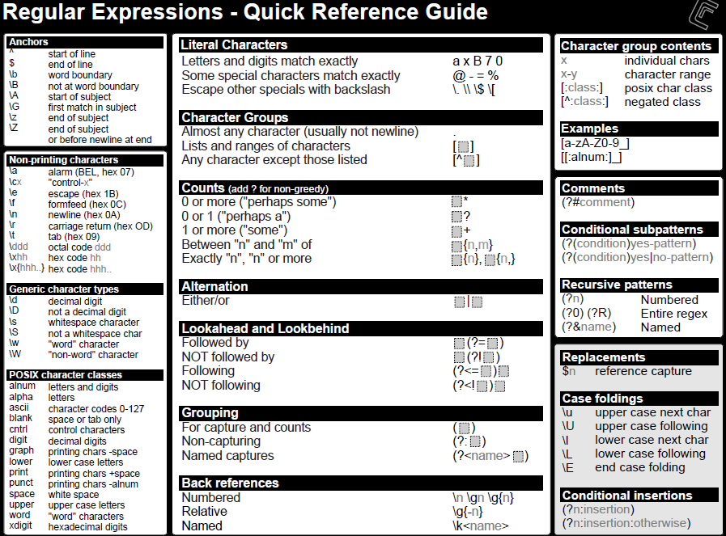
Regular Expression (Contd..)
Notes:
For more details on regular expression, refer http://www.regular-expressions.info/
© Copyright IBM Corporation 2015

Slide 55
Regular Expressions (Contd..)
Character Classes
[abc] a, b, or c (simple class)
[^abc] Any character except a, b, or c (negation)
[a-zA-Z] a through z or A through Z, inclusive (range)
[a-z-[bc]] a through z, except for b and c: [ad-z] (subtraction)
[a-z-[m-p]] a through z, except for m through p

Slide 56
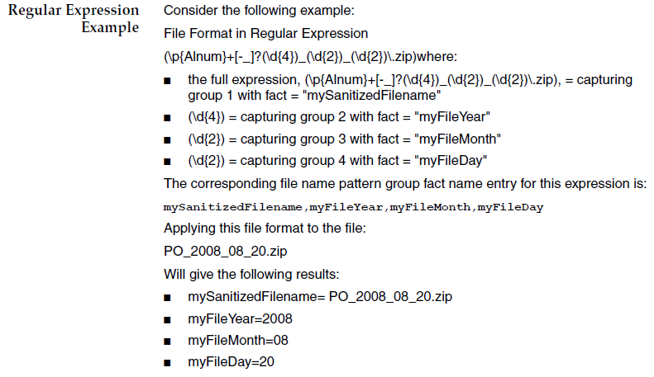
Regular Expression (Contd..)
Example

Slide 57
Exercise
Graphic must not be moved, added to, or altered in any way.
  Create a Routing Channel Template
Notes:
© Copyright IBM Corporation 2015

Slide 58
Completed lesson objectives
Describe the components of a Routing Channel Template.
Explain the difference between System facts and Custom facts.
Describe the file structures usage in Sterling File Gateway.
Explain the difference between container and non-container file layers.
© Copyright IBM Corporation 2015
Notes:
© Copyright IBM Corporation 2015

Slide 59
Questions
© Copyright IBM Corporation 2015
Notes:
© Copyright IBM Corporation 2015

Slide 60
Lesson 4
Mailbox Management
© Copyright IBM Corporation 2015
Notes:
© Copyright IBM Corporation 2012

Slide 61
Lesson objectives
Describe Sterling B2B Integrator mailboxes.
Identify the location of the producer and consumer mailbox.
Extract data from a mailbox of producer and consumer.
Explain the importance of global mailbox in Sterling File Gateway.
© Copyright IBM Corporation 2015
Notes:
© Copyright IBM Corporation 2015

Slide 62
Sterling Integrator Mailboxes
The Sterling Integrator Mailbox system is a secure business document repository with a store-and-forward communication infrastructure.
In addition, the Sterling Integrator Mailbox provides a trading partner browser interface called the Mailbox Browser Interface (MBI). The MBI is secure and simple to use, requiring no special user training.
Sterling Integrator Mailbox Components
  MBI
  Messages
  Mailbox
  Archive

Slide 63
Mailbox Browser Interface
The Mailbox Browser Interface (MBI) enables Internet users to securely access their mailboxes from a standard Web browser. The MBI is a Web application and therefore requires only a browser.
Users can send messages to, retrieve messages from, and search messages in any mailbox for which they have permissions.
The MBI enables users to change their account password.

Slide 64
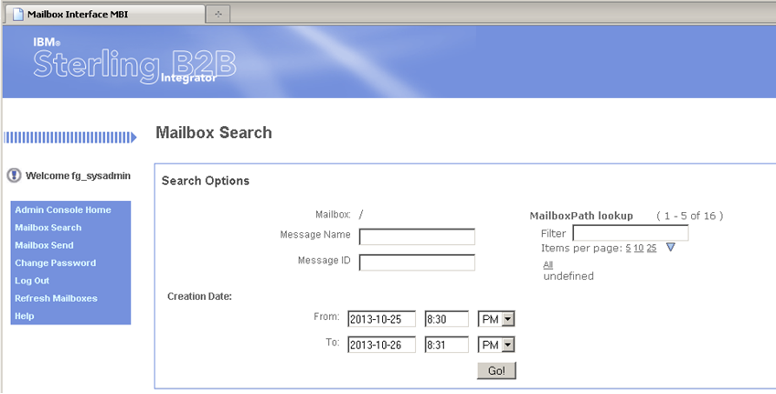
Mailbox Browser Interface (Contd..)
http://192.168.40.100:9000/mailbox

Slide 65
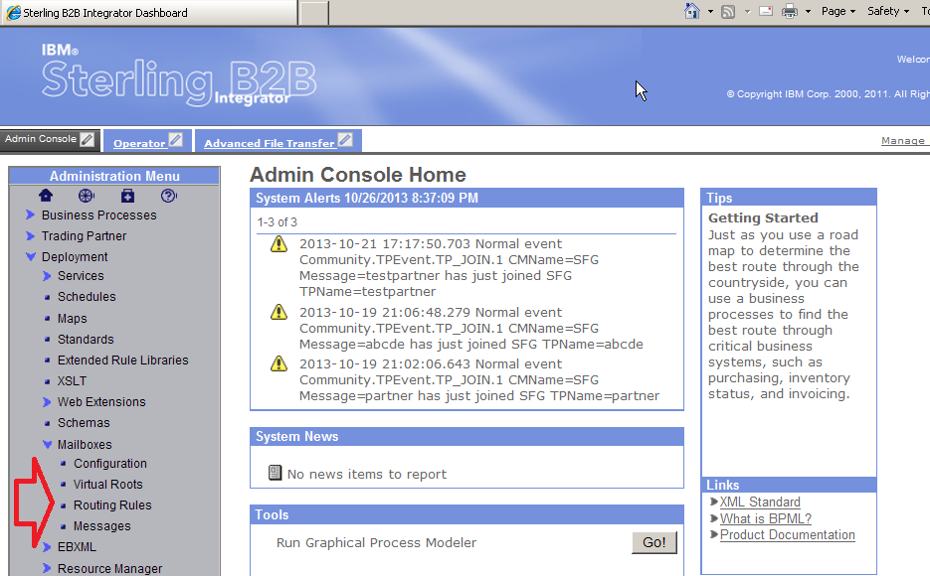
Sterling B2B Integrator Mailboxes
http://192.168.40.100:9000/dashboard

Slide 66
Mailbox Messages
Messages : Business documents stored in the Sterling Integrator Mailbox are called messages.
Mailbox :
A mailbox is a storage area for business documents and provides an administrative hierarchy that is easy to manage and understand.
Mailboxes form a hierarchy. The top of the hierarchy is called the root mailbox and is denoted by a slash (/). Mailboxes are able to support sub-mailboxes.
A key function of Sterling File Gateway is the routing of files from one mailbox to another. Sterling File Gateway uses the mailbox system within the Sterling Integrator application for its routing of messages.

Slide 67
Mailbox Creation
Mailboxes used for Sterling File Gateway operations can be created automatically in the following circumstances:
  When a Partner is created in Sterling File Gateway
  When Partners are migrated from Advanced File Transfer
  When Partners are imported into Sterling Integrator
  When a Routing Channel is created
  At file transfer runtime (using dynamic routing channel templates)

Slide 68
Mailbox Routing Rules
Routing rules provide a powerful and easy-to-use mechanism for controlling document routing.
You can create routing rules to initiate action automatically when a message is added to a mailbox. Automatic routing assures that the rule is evaluated at least once. When a message is added to a mailbox, any rules established for the Sterling Integrator Mailbox are evaluated automatically.
Routing rules consist of two parts: a pattern to specify when the rule applies, and an action to be performed.

Slide 69
Routing Rule Evaluation Mode
When a routing rule is evaluated, Mailbox searches the mailboxes defined in the rule for message names that match the pattern defined in the rule.
When a match is found, the routing rule notifies the business process or contract specified in the routing rule.
Depending on how the business process is defined, it may extract and process the message, extract the message and pass it to another application for processing, or notify another application to extract and process the message.

Slide 70
Additional Mailbox Information
Disable Duplicate Messages:
1. In the install_dir/properties directory, locate (or create if necessary) the customer_overrides.properties file.
2. Open the customer_overrides.properties file in a text editor.
3. Add the following parameter: mailbox.disallowDuplicateMessages=true

Slide 71
Distributed mailbox
IBM Global High Availability Mailbox is an add-on component of IBM Sterling B2B Integrator and is robust and reliable to store and replicate message data from partners across any geography.
Current approaches to provide high available B2B and MFT environment:
Shares payload across data centers at the communications layer for various protocols.
Asynchronous or Synchronous data replication is configurable by mailbox.
A consistent view is provided across data centers of what files get processed and where regardless of data center status.
Transaction processing is balanced across distribution centers.
Integration with Control Center v6.1 to monitor system health.
© Copyright IBM Corporation 2015

Slide 72
Exercise
Graphic must not be moved, added to, or altered in any way.
Locate Mailboxes
Enable Routing Rule Schedule
View disabled duplicate message
Notes:
© Copyright IBM Corporation 2015

Slide 73
Completed lesson objectives
Describe Sterling B2B Integrator mailboxes.
Identify the location of the producer and consumer mailbox.
Extract data from a mailbox of producer and consumer.
Explain the importance of global mailbox in Sterling File Gateway.
© Copyright IBM Corporation 2015
Notes:
© Copyright IBM Corporation 2015

Slide 74
Questions
© Copyright IBM Corporation 2015
Notes:
© Copyright IBM Corporation 2015

Slide 75
Lesson 5
Static Route
© Copyright IBM Corporation 2015
Notes:
© Copyright IBM Corporation 2012

Slide 76
Lesson objectives
Transfer files using Static Routing.
Explain the different ways to upload a file in Sterling File Gateway.
Edit and monitor Routing Channel result.
Analyze the routes file transfer in myFileGateway and File Gateway.
© Copyright IBM Corporation 2015
Notes:
© Copyright IBM Corporation 2015

Slide 77
Routing Channels
Routing channels match incoming producer files to the appropriate consumer and then transform the file and file name according to the policies of the consumer.
Route Provisioners create routing channels. Before routing channels can be created, the Integration Architect should create a routing channel template and the Route Provisioner should create the producer and consumer Partners.
For a static routing channel, the consumer is explicitly identified during the configuration, and there is only one consumer.
For a dynamic routing channel, no consumer is explicitly specified.

Slide 78
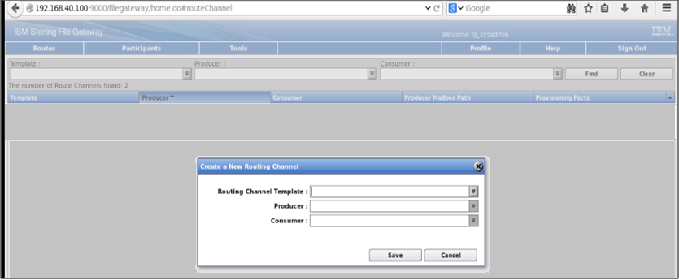
Creating a Routing Channel - Static

Slide 79
Myfilegateway
Myfilegateway is a partner interface for the producer and consumer to upload and download files.
  Characteristics of Myfilegateway are:
    Upload or download files.
    Search for routes
    View recent activity and status for file transfers they participated in.
    Generate reports for activity they participated in.
    Generate PDF reports in Asian languages.
    Subscribe to notifications.
    View and update profile information.
MyFileGateway requires access to a valid user account. This user account is created when a Route Provisioner creates the Partner.
If you select a static template, select a producer and a consumer. If you select a dynamic template, select only a producer.

Slide 80
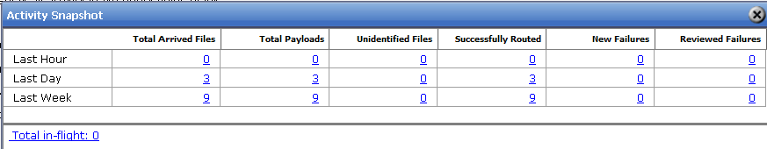
Visibility
You can view activity status information for the last hour, day, and week.
From the main menu, navigate to Tools > Activity Snapshot
Total in-flight lists the producer’s arrived files currently being processed, These files have not yet moved to a completed state.
Notes:
For more details, refer: http://www.ibm.com/support/knowledgecenter/SS4TGX_2.2.0/com.ibm.help.sfg_operator.doc/SFGViewSysStatus.html?lang=en
© Copyright IBM Corporation 2015

Slide 81
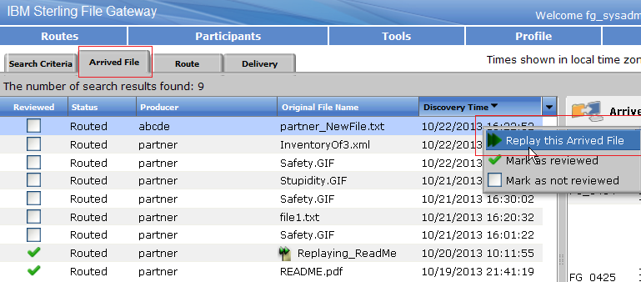
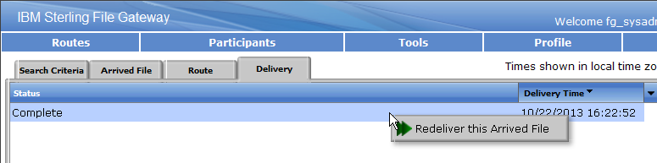
Replay and ReDeliver

Slide 82
Mailbox Services
Mailbox Extract Begin service – Enables the extraction of messages from a mailbox.
Mailbox Extract Commit service – Provides the ability for a business process to signal Sterling B2B Integrator Mailbox that the message extract request has successfully completed.
Mailbox Query service – Enables querying messages.
Mailbox Delete service – Enables deletion of messages.
Mailbox Evaluate All Automatic Rules service – Provides for the scheduling of automatic routing rules for Sterling B2B Integrator Mailbox.
Mailbox Evaluate Routing Rule service – Enables triggering of mailbox routing rules from a business process.

Slide 83
Exercise
Graphic must not be moved, added to, or altered in any way.
Create a routing channel
Upload a file using myfilegateway
Analyze uploaded file transfer
Creating a listening partner
Set up directories in FTP
Upload file to initiate FTP process
Disable FTP configuration from listening partner
Extracting date from mailbox repository using a business process.
Notes:
© Copyright IBM Corporation 2015

Slide 84
Completed lesson objectives
Transfer files using Static Routing.
Explain the different ways to upload a file in Sterling File Gateway.
Edit and monitor Routing Channel result.
Analyze the routes file transfer in myFileGateway and File Gateway.
© Copyright IBM Corporation 2015
Notes:
© Copyright IBM Corporation 2015

Slide 85
Completed unit objectives
Explain the Sterling File Gateway application terms and concepts.
Discuss the Sterling File Gateway installation.
Explain users, trading partners groups and communities.
Create routing channel template and routing channel for static route.
© Copyright IBM Corporation 2015
Notes:
© Copyright IBM Corporation 2015

Slide 86
Questions
© Copyright IBM Corporation 2015
Notes:
© Copyright IBM Corporation 2015

